Slide 1
PASS : Physically-Aware Secure Software Execution
PIs: Dr. Mark Tehranipoor (tehranipoor@ufl.edu), Dr. Farimah Farahmandi (ffarahmandi@ufl.edu)

Slide 2
Research Question
- Does my software know it is running on vulnerable hardware?
- Can I tell my software about underlying hardware vulnerabilities so that it can mitigate those and execute more securely?

Slide 3
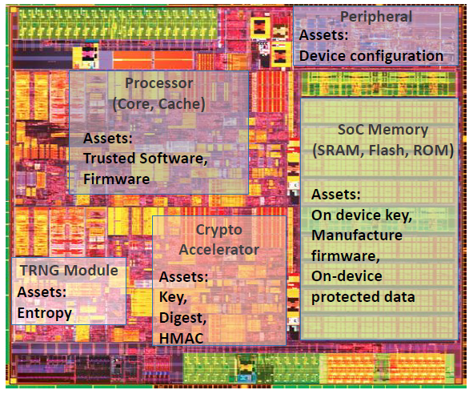
Problem Statement
Problem: Protect assets
On-device keys (crypto/obfuscation)
Manufacturer firmware
Application software
On-device sensitive data, etc.
Software running on vulnerable circuits are not secure
Software executed in SoCs, processors, IoT devices, and smartphones is susceptible to both cyber attacks and hardware attacks
Physical attack targets the implementations, bypassing upper-level protections; it’s a powerful attack type compromising the confidentiality, integrity, and availability of modern chips
Software developers/compilers are not informed of physical attacks (fault injection, side channel, data extraction, etc.)
The only existing physical modeling in compilers is based on unrealistic software-based predictions [1]
Source: Intel
Notes:
Modern SoCs are made of different components which house a variety of security assets and sensitive data which need to be protected from unauthorized access.
These assets are targets of a myriad of cyber attacks including hardware attacks. Hardware attacks, most notably, physical attacks are of particular concern because they mostly target the lowest abstraction level and in doing so it can easily bypass security and countermeasures implemented at upper levels. So my software could be perfectly secure, but the underlying hardware could be compromised by a fault injection attack and the software would have no clue about it.
Existing efforts have tried to predict it using observable characteristics from the upper level. Most physical characteristics are not observable from the upper level because of abstraction and thus these upper-level predictions are unrealistic and ineffective.

Slide 4
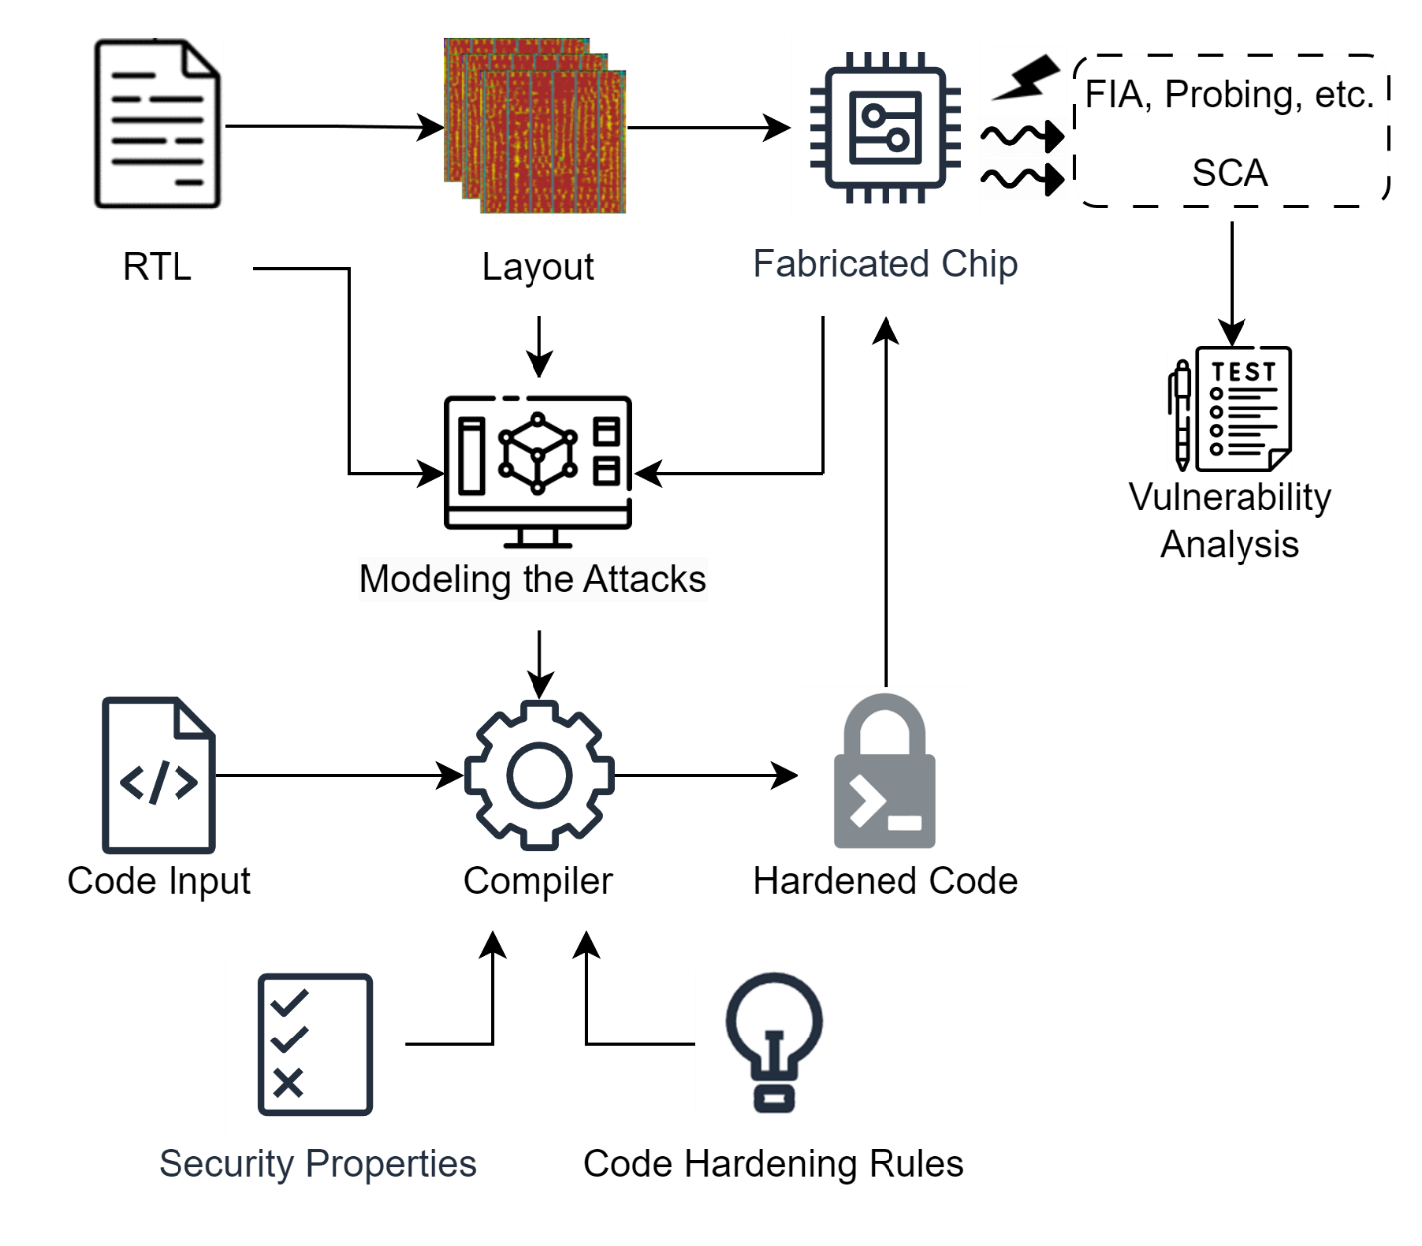
Motivations and Goals
Motivations
Addressing physical threats from code compilation is fast, powerful, scalable, and cost-effective
Existing physical modeling in compilers is only based on software-side predictions [1]
Objectives
The objective is to harden the software code against as many physical vulnerabilities as possible at the compilation stage.
Effective physical modeling to help improve the compilation process
Making code resistant to physical attacks at compilation stage
Software Hardening against Physical Attacks at Compilation
Notes:
So our project aims to develop a hardened compiler that can take a high level non hardened code and compile it into physically hardened machine level code. The compilation stage is perfect for implementing this hardening bc the software is linked to underlying hardware during this stage.
First major step is physical modelling of the attacks. In other words, how can we describe a physical attack in terms of physical characteristics of the chip. So we take the layout level information of a fabricated chip and simulate physical attacks on it. After simulating the attacks we analyze the differences in physical characteristics before and after the attack to define the physical model for that particular attack.
Once we have modeled the attack we can implement security properties and corresponding hardening techniques. These hardening techniques are applied during compilation, so we get a physically hardened machine code.
Lastly, its important we evaluate our hardening by running the hardened code on the same chip and analyzing how much improvement we are seeing and in which areas.

Slide 5
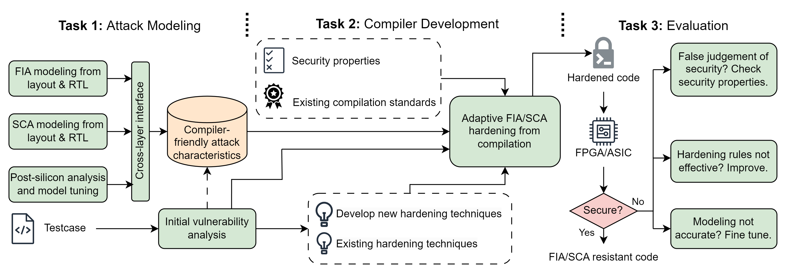
Objective and Tasks
Objective: We propose PASS: a novel, cost-effective, scalable, and adoptable approach for addressing physical threats as many as possible at the software compilation stage.
Task 1: a comprehensive modeling methodology for existing physical attack techniques
Task 2: guided by attack models, we develop and apply software hardening techniques against physical vulnerabilities
Task 3: an extensive evaluation of the PASS flow on SoCs implemented on FPGAs
Overview of PASS flow: physically-aware secure software execution
Notes:
We propose PASS: a novel, cost-effective, scalable, and adoptable approach for addressing physical threats at the software compilation stage.
Task 1: Attack Modeling
We assume one or both of the following steps are performed first:
Physical attacks are modeled based on hardware characteristics at the SPICE/layout-level
Performing post-silicon physical attacks/test on the chip/SoC running the software. If the chip passes the security test, no further action is needed. When the chip fails the test, the collected data and response will help validate and fine-tune the attack models.
Task 2: Compiler Development
We use security properties to define security-sensitive scenarios, and develop a database for hardening techniques.
The attack models’ output, in the form of analog variations, will facilitate establishing the sense of attack criticalities and feasibilities under given attack scenarios, thereby informing the software compiler to avoid such attacks.
Task 3: Evaluation
We perform post-silicon validations on the hardened software. The results will help broaden the hardening technique database, modeling accuracy, etc., so this iterative flow will address physical threats on software as many as possible.

Slide 6
Deliverables
Year 1 (1/1/2025-12/31/2025)
Q1-3. SPICE-level and layout-level modeling of the physical characteristics of fault-injection and side-channel attacks;
Q4. Post-silicon attack test on chip/SoC, perform vulnerability analysis of software executions, improve the attack models.
Year 2 (1/1/2026-12/31/2026)
Q1. Investigation and development of physically-aware hardening techniques;
Q2. Developing executable security properties and LUT/ML-based model interfaces to guide hardening strategies.
Q3-4. Integration of hardening techniques into software compilation in the form of GCC plug-in/LLVM/Clang;
Year 3 (1/1/2027-12/31/2027)
Q1-2. Extensive validation of the PASS flow on FPGAs with the iterative test of hardened software compilations;
Q3-4. Broadening the attack scenarios by including more security properties and fine-tuning of physical attack models.
 | Year 1 |  | Year 2 |  | Year 3
Task 1: Attack Modeling
Task 2: Compiler Development
Task 3: Evaluation
Notes:
This is a 3-year project, we aim to deliver tools and methodologies through the process of this project.
Year 1: We develop attack models from one of, or both of the pre-silicon attack simulations and post-silicon tests.
Year 2: We plan to deliver the compilers integrated with software hardening techniques, the hardening strategies are guided by attack models and testable for given security properties.
Year 3: We aim to deliver both the completed hardening methodology and hardened software validated on FPGAs.

Slide 7
Task 1: FIA/SCA Modeling
Technical Approach
Understand the logical impact of FIA/SCA
Understand the physical behavior of FIA/SCA
Through RTL/layout-level/post-silicon simulations and experiments, model the FIA/SCA effects under given input parameters
For FIA, laser/optical fault-injections, clock/voltage glitching, and EM fault-injections have different mechanisms and modeling approaches
Identify the cross-layer effects: how does the physical fault eventually impact the code execution?
Deliverables
Model equations or look-up tables

Slide 8
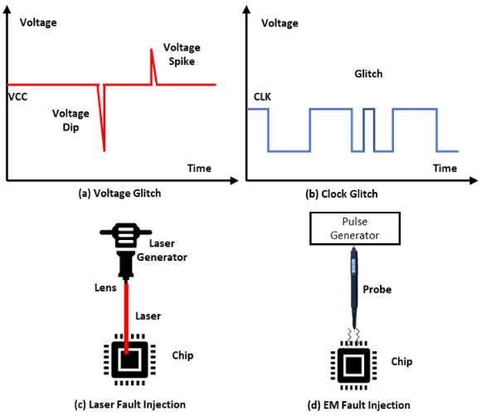
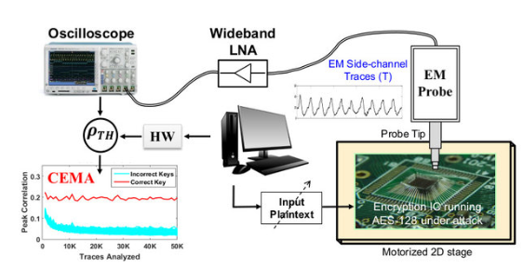
Task 1: FIA/SCA Modeling
Physical Attacks
Fault-injection attack (FIA)
Clock/voltage glitching, laser/optical fault-injections, EM fault-injection
Side-channel attack (SCA)
Leakages from power, EM, optical, thermal, acoustic, etc.
Can be monitored and analyzed to leak sensitive info
Side channel attack flow
Illustration of different physical fault injection attacks

Slide 9
Task 1: FIA/SCA Modeling
Fault Injection Modalities
Example: laser fault-injection modeling from layout info
Laser effect can be modeled as extra current sources in SPICE simulations, then applied in dynamic IR drop simulations (result: build a connection between laser intensity per cell and cell’s accurate current demand)
Cells’ current demand under laser impact will determine whether the fault can be injected
Example: clock/voltage glitch modeling from layout info
Clock/voltage glitch causes timing violations across the sequential components
Can be modeled as delay changes, i.e., converting fault to time

Slide 10
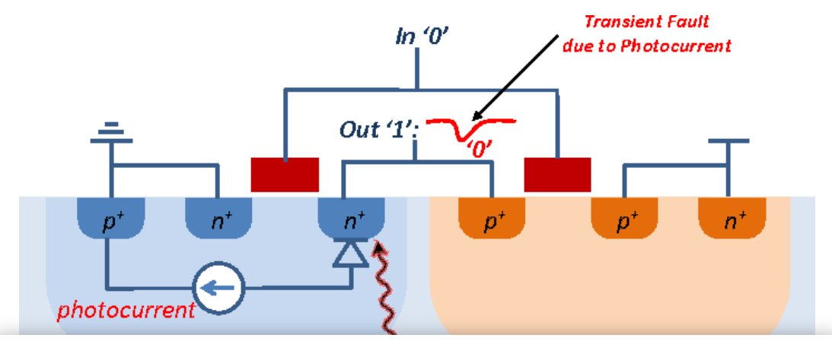
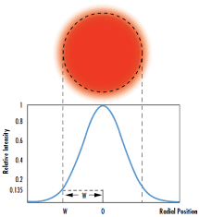
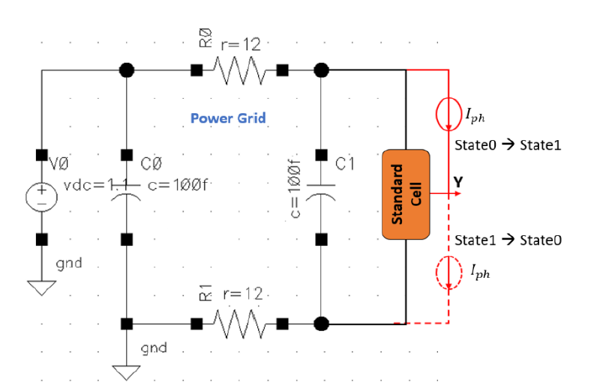
Task 1: FIA/SCA Modeling
Laser Fault Injection
Transient faults can be introduced by laser induced photocurrent
Laser Intensity can be modeled by a Gaussian distribution
SPICE model of a standard cell under Laser Fault Injection
Notes:
Insert diagram descriptions

Slide 11
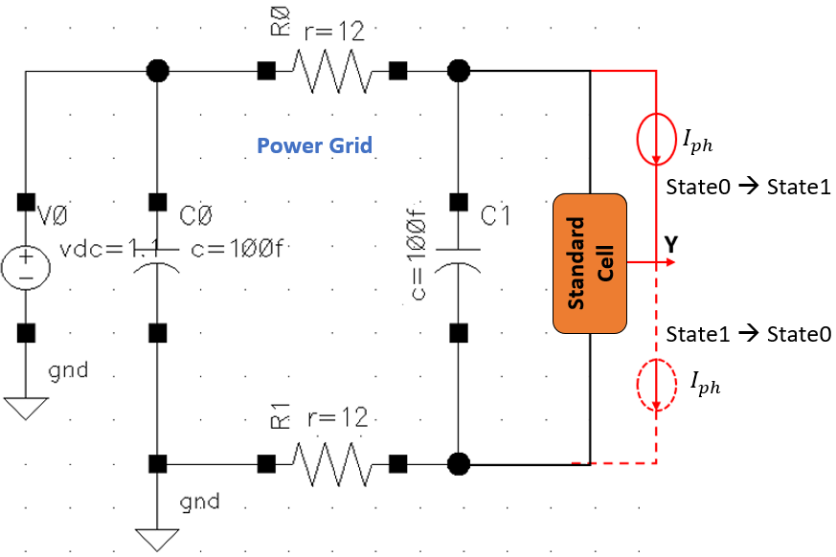

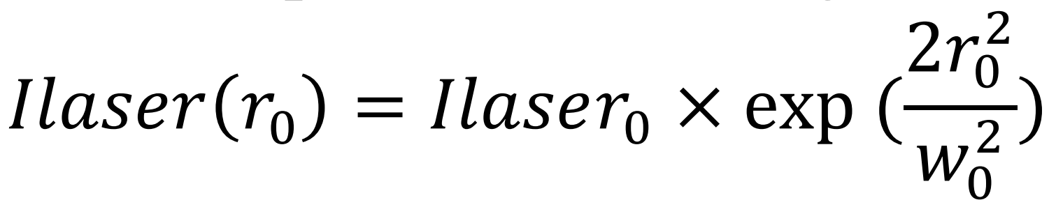
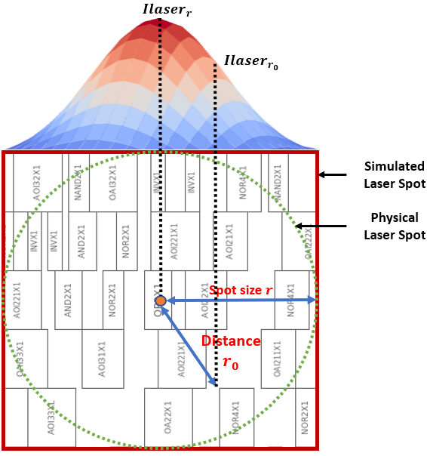
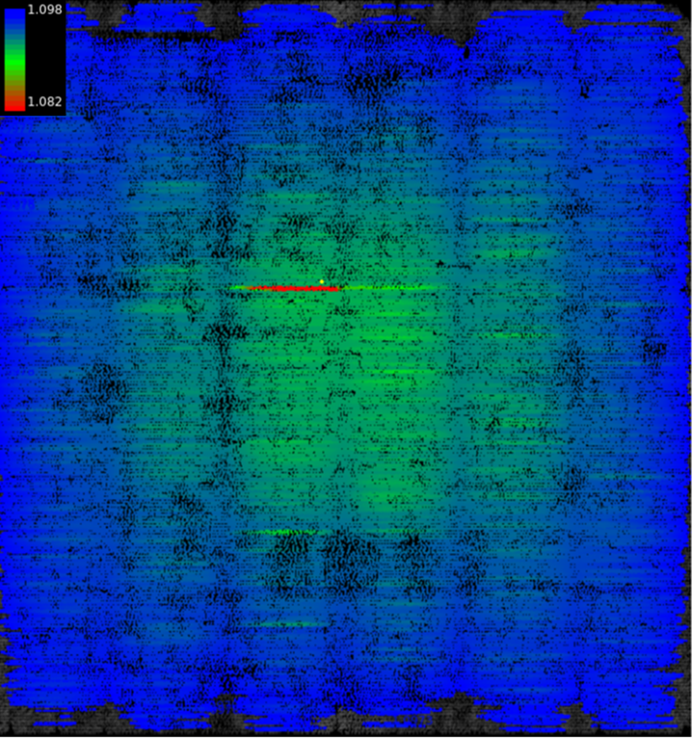
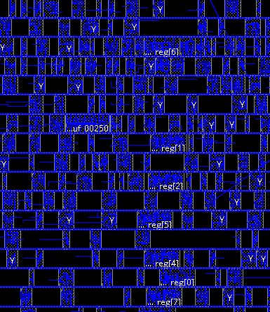
Task 1: FIA/SCA Modeling
Laser Fault Injection Modeling
Repeat for all type of standard cells
Voltage drop simulation on the layout
Substitute impacted cells’ current
response with laser-impacted version
Laser fault modeling

Slide 12
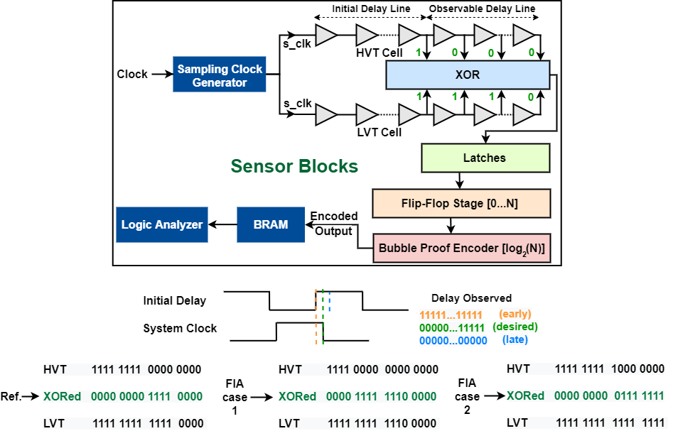
Task 1: FIA/SCA Modeling
Example: laser fault-injection modeling from layout info
Laser effect can be modeled as extra current sources in SPICE simulations, then applied in dynamic IR drop simulations (result: build a connection between laser intensity per cell and cell’s accurate current demand)
Cells’ current demand under laser impact will determine whether the fault can be injected
Example: clock/voltage glitch modeling from layout info
Clock/voltage glitch causes timing violations across the sequential components
Can be modeled as delay changes, i.e., converting fault to time

Slide 13
Task 1: FIA/SCA Modeling
Threat Model and Assumptions
An adversary’s objective is to tamper with security-critical locations and violate security properties
Grey box attack model
Require physical access to the target device
Non-invasive or semi-invasive(backside polishing) fault injection
Attacker has access to certain optical/opto-electrical setup-
Laser source, ex: Diode laser
Optical source, ex: Flash gun
Measurement tools, ex: PC, oscilloscope etc.

Slide 14
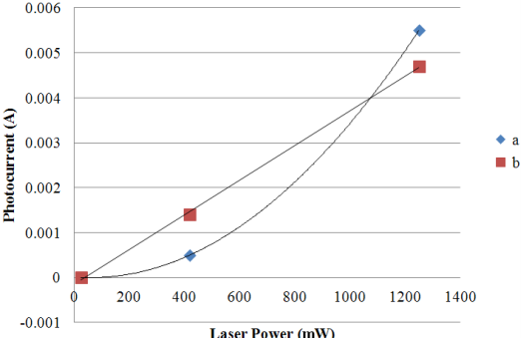
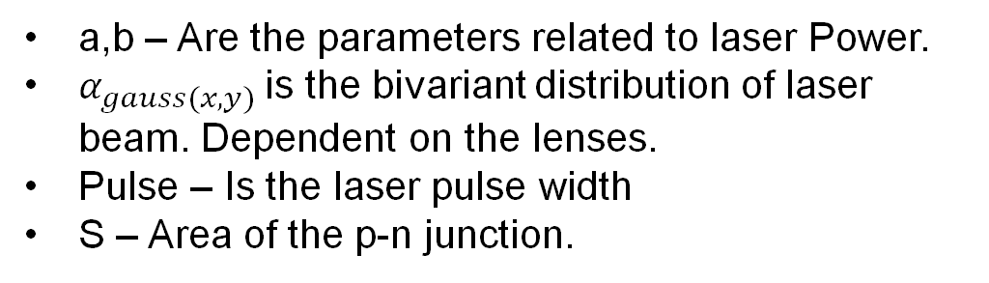
Electrical Modeling of the Laser
Task 1: FIA/SCA Modeling
a,b – Are the parameters related to laser Power.
$α_{gauss(x,y)}$is the bivariant distribution of laser beam. Dependent on the lenses.
Pulse – Is the laser pulse width
S – Area of the p-n junction.
Laser power (1000 mW – 5000 mW)
45 nm Tech node
I_{Ph_peak} ~ (144 uA-600 uA)
Parameter a is exponentially related while parameter b is linearly related to Laser Power

Slide 15
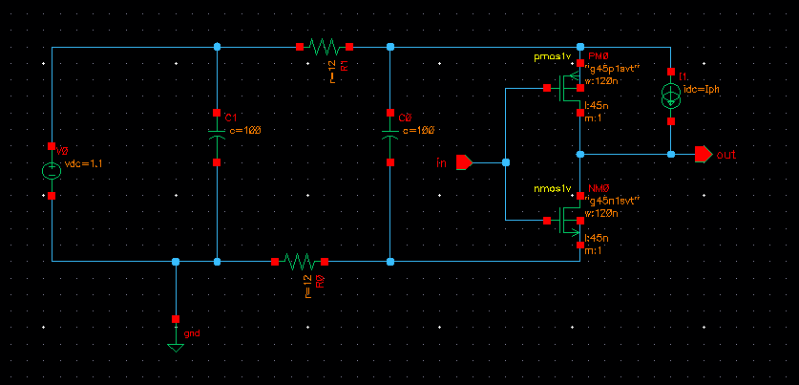
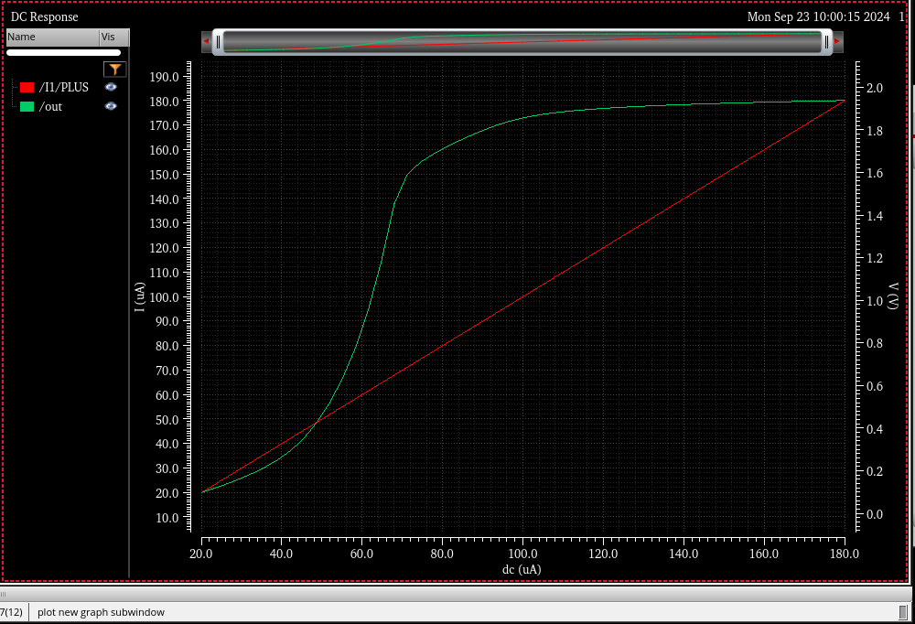
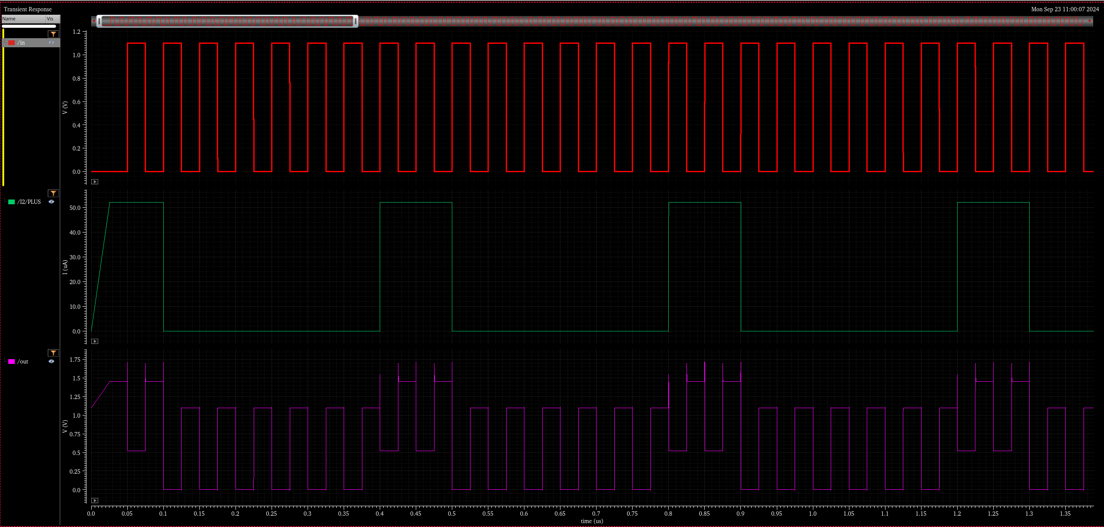
SPICE Simulation of Standard Cells
Inverter
Laser sensitive region for output state 0 ->1
Voltage levels for for output state flipped 0 ->1
Output waveform for output state flipped 0 ->1

Slide 16
Standard Cell Simulation
Spice simulation for 45 nm tech mode during pull-up
Standard Cell | I_{ph} Threshold (0 → 1) (uA) for Gate Size of 120nm (X1) | I_{ph} Threshold (0 → 1) (uA) for Gate Size of 240 nm (X2) | I_{ph} Threshold (0 → 1) (uA) for Gate Size of 480nm (X4)
Inverter | 57 | 120 | 227
Nand2x1 | 84 | 178 | 325
And2x1 | 81 | 163 | 313
Nor2x1 | 63 | 137 | 250
Or2x1 | 77 | 144 | 309
Xor2x1 | 88 | 164 | 345
Xnor2x1 | 86 | 172 | 332
AOI21x1 | 98 | 208 | 392
OAI21x1 | 101 | 199 | 412
AO21x1 | 97 | 190 | 368
DFF | 144 | 224 | 374

Slide 17
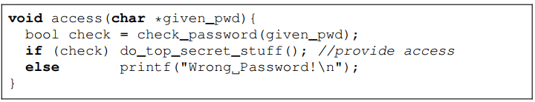
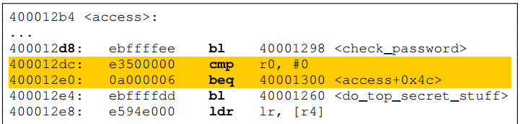
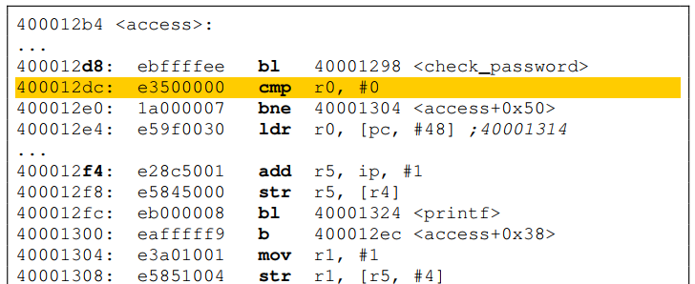
Task 2: Compiler Development
Hardening rules database
Goal: address the physical faults during the compilation process
Review existing hardening approaches
Utilize or imitate existing solutions in RISC-V GNU compiler
Develop adaptive approach to apply countermeasures using the info (e.g., vulnerability ranking) given by modeling output
Deliverables
Encapsulated implementation of hardening compiler
Proper documentations
Compile
Harden
What happened?
Faults modifying/bypassing the conditional jump will now directly lead to a password-checking failure

Slide 18
Task 2: Compiler Development
Test case and security properties
Aims for C/C++ -> Assembly code compilation and hardening
Started with firmware, AES software, password checking, etc.
Corresponding security properties acquired from existing standards and powerful attack scenarios
Modeling-compiler interface
Modeling considers logical & physical info, thus, the outcome needs translation to be compiler-friendly
Compiler must provide:
A configurable “hardening level” input to determine the input (e.g., laser intensities) for FIA models
A simple mechanism to determine target instructions (e.g., directly extract sensitive instructions from security properties; or through static code analysis.)
Translation from target instructions to actual instances/area, which serves as final input for models
Compiler must receive:
Feedback from modeling in a compatible form of either 1) a threat level / a vulnerability ranking of inputted sensitive instances, or 2) a simple secure-or-not judgements from modeling under certain parameter inputs

Slide 19
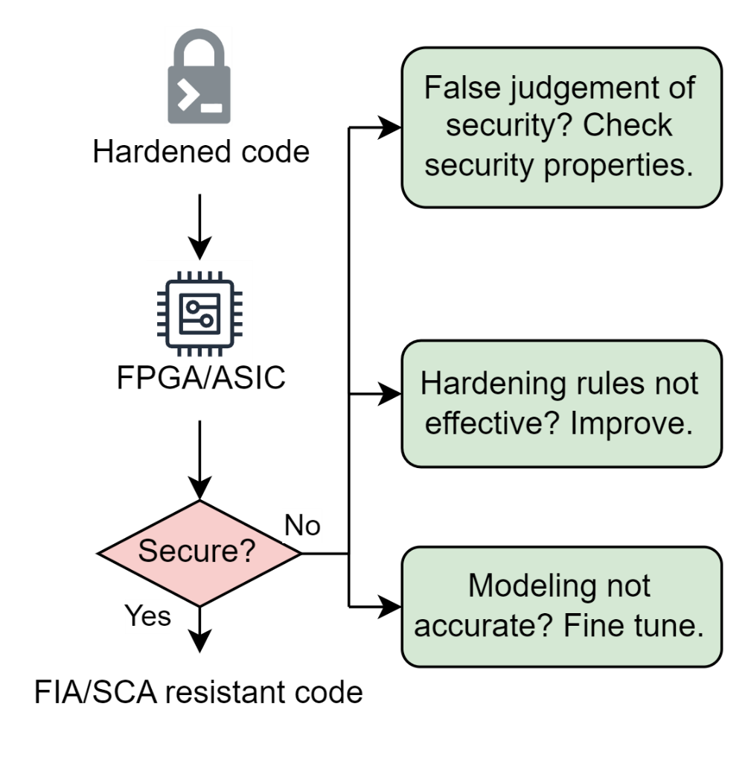
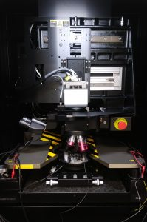

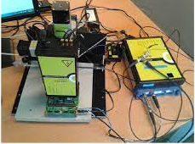
Task 3: Evaluation
Technical Approach
Execute hardened codes on FPGA/ASIC
Perform FIA/SCA vulnerability analysis
Evaluate the hardened code’s resistance, root-cause any issues, automate and improve the compilation flow
Deliverables
FIA/SCA resistant code proven from physical modeling-assisted compilation
FICS lab houses state-of-the-art instruments and capabilities to perform cutting-edge research from device-to-system assurance, security, and integrity analysis.

Slide 20
References
[1] D. Pozza and R. Sisto, "A Lightweight Security Analyzer inside GCC," International Conference on Availability, Reliability and Security, Barcelona, 2008.
[2] N. Moro et al., “Electromagnetic Fault Injection: Towards a Fault Model on a 32-bit Microcontroller,” 2013 Workshop on Fault Diagnosis and Tolerance in Cryptography, 2013.
[3] M. M. Hossain, F. Rahman, F. Farahmandi, and M. Tehranipoor, Software Security with Hardware in Mind, in Emerging Topics in Hardware Security, Springer, 2021.
[4] A. Nahiyan, F. Farahmandi, M. Tehranipoor et al., "Security-Aware FSM Design Flow for Identifying and Mitigating Vulnerabilities to Fault Attacks," IEEE Transactions on Computer-Aided Design of Integrated Circuits and Systems, vol. 38, no. 6, pp. 1003- 1016, June 2019.
[5] H. Wang, M. Tehranipoor, F. Farahmandi et al., “SoFI: Security Property-Driven Vulnerability Assessments of ICs Against Fault-Injection Attacks,” 2020 IEEE Transactions on Computer-Aided Design of Integrated Circuits and Systems (TCAD), 2020.
[6] H. Li, L. Lin, N. Chang, M. Tehranipoor et al., "Photon Emission Modeling and MachineLearning Assisted Pre-Silicon Optical Side-channel Simulation," IEEE International Symposium on Hardware Oriented Security and Trust (HOST), 2024.
[7] J. Laurent et al., “Cross-layer analysis of software fault models and countermeasures against hardware fault attacks in a RISC-V processor”, Microprocessors and Microsystems, Volume 71, 2019.
[8] A. Höller et al., "QEMU-Based Fault Injection for a System-Level Analysis of Software Countermeasures Against Fault Attacks," 2015 Euromicro Conference on Digital System Design, Madeira, Portugal, 2015, pp. 530-533.
[9] N. J. Wang et al., “Characterizing the effects of transient faults on a high-performance processor pipeline, in: International Conference on Dependable Systems and Networks”, 2004, pp. 61–70.
[10] G. Agosta et al., "Compiler-Based Techniques to Secure Cryptographic Embedded Software Against Side-Channel Attacks," IEEE Transactions on Computer-Aided Design of Integrated Circuits and Systems, vol. 39, no. 8, pp. 1550-1554, Aug. 2020.
[11] M. R. Muttaki, T. Zhang, M. Tehranipoor and F. Farahmandi, "FTC: A Universal Sensor for Fault Injection Attack Detection," 2022 IEEE International Symposium on Hardware Oriented Security and Trust (HOST), McLean, VA, USA, 2022, pp. 117-120.
[12] N. Vashistha et al., "Is Backside the New Backdoor in Modern SoCs?: Invited Paper," 2019 IEEE International Test Conference (ITC), Washington, DC, USA, 2019, pp. 1-10.
[13] M. Dhwani, M. Tehranipoor et al., “On the physical security of ai accelerators,” International Conference on Physical Assurance and Inspection of Electronics, 2019.

Slide 21
Thank You

Slide 22
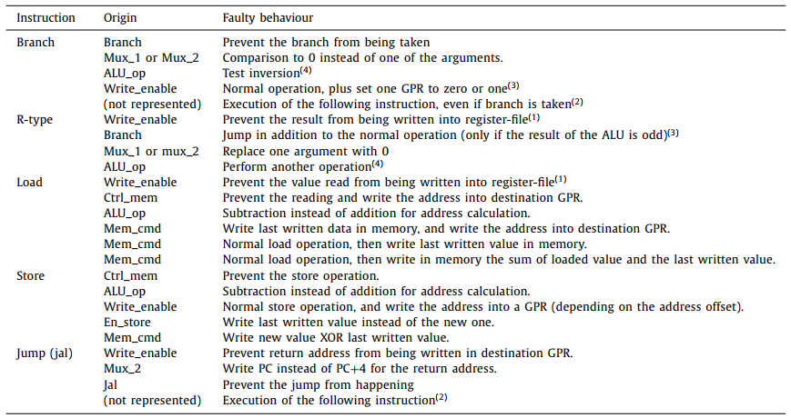
Problem Statement
A Simple Example to Motivate the Work:
The faulty behavior in many different types of RISC-V instruction shows a powerful potential for attackers to manipulate the program execution
Notes:
Faults marked with a number are complex/combined faults, explained in reference paper 5.

